Slide 1
Early Momentum Forecasting
Team B09:
Aryan Jain, Ahrar Karim, Drishti Chulani, Linh Le, Sai Leela Rahul Pujari

Slide 2
01
Executive Summary
Notes:
L

Slide 3

Business Problem
E-commerce wins are driven by early identification of high-potential products.
Predicting top performers within the first 7–14 days enables smarter promotions, inventory decisions, and seller support before demand peaks.
Our model uses early sales patterns to predict top 10% products using 60-day sales
Notes:
L

Slide 4

Motivation
Identification of early momentum patterns and segments products by trajectory (trending vs late-bloomer).
Helps optimize marketing spend, inventory allocation, and product lifecycle strategy.
Supports marketing, inventory, and marketplace teams with smarter promotions, fewer stockouts, and better seller guidance.
Notes:
L

Slide 5

Datasource
Real transaction data from Olist, Brazil’s largest marketplace, spanning Oct 2016 – Sep 2018.
Includes product listings, orders, payments, shipping details, and customer reviews.
Represents activity from small businesses selling across multiple Brazilian marketplaces.
Data Size ~ 113,000 records
~ 50+ columns
Notes:
L

Slide 6
02
Exploratory
Data
Analysis
Notes:
D

Slide 7
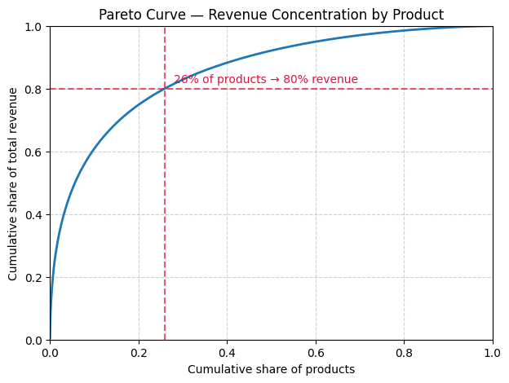
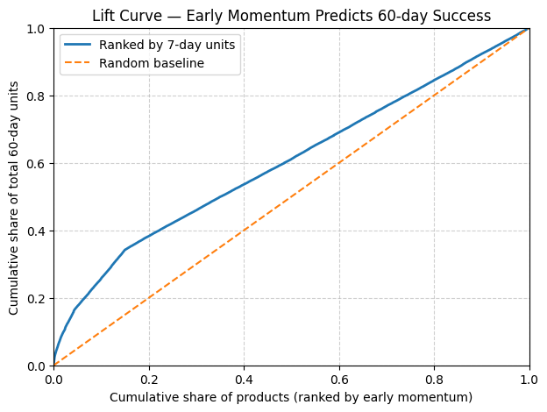
E-commerce follows a Classic Pareto pattern (80/20).
Only 20% of products generate ~80% of total revenue, meaning revenue is highly concentrated among a small set of winners.
Most products contribute very little, while a few high performers drive the business.
Demonstrates how well early sales (first 7 days) predict long-term success (60-day units).
The blue line (ranked by early momentum) is well above the orange random baseline.
This means products that sell well in the first week disproportionately make up later sales.
Notes:
D

Slide 8
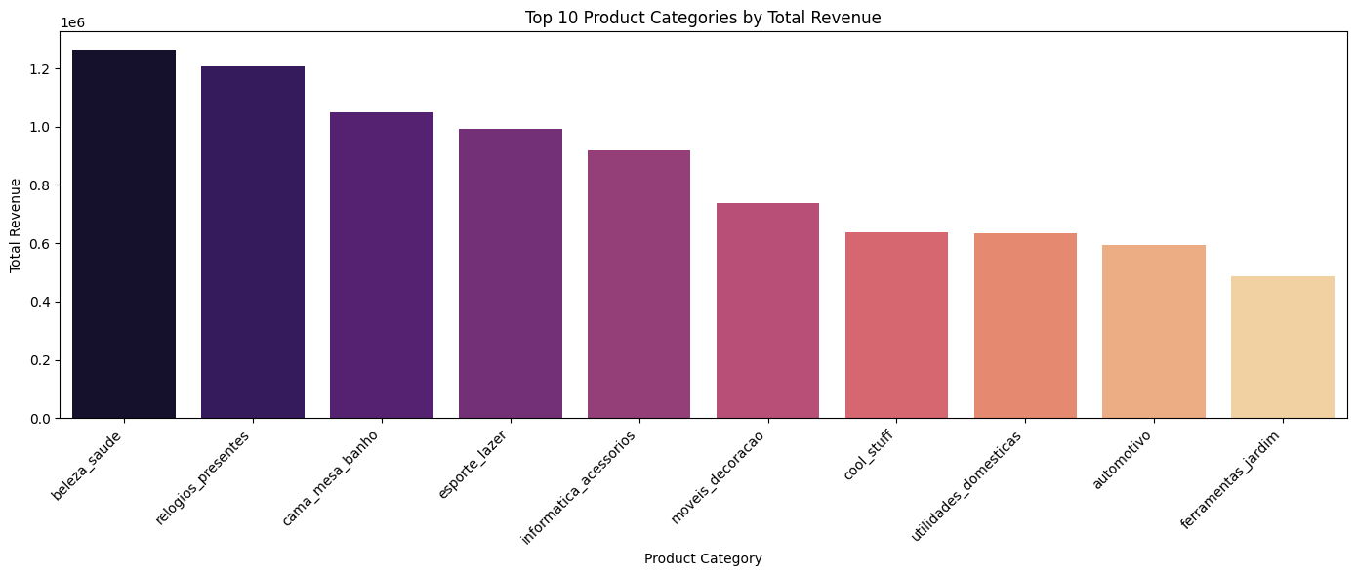
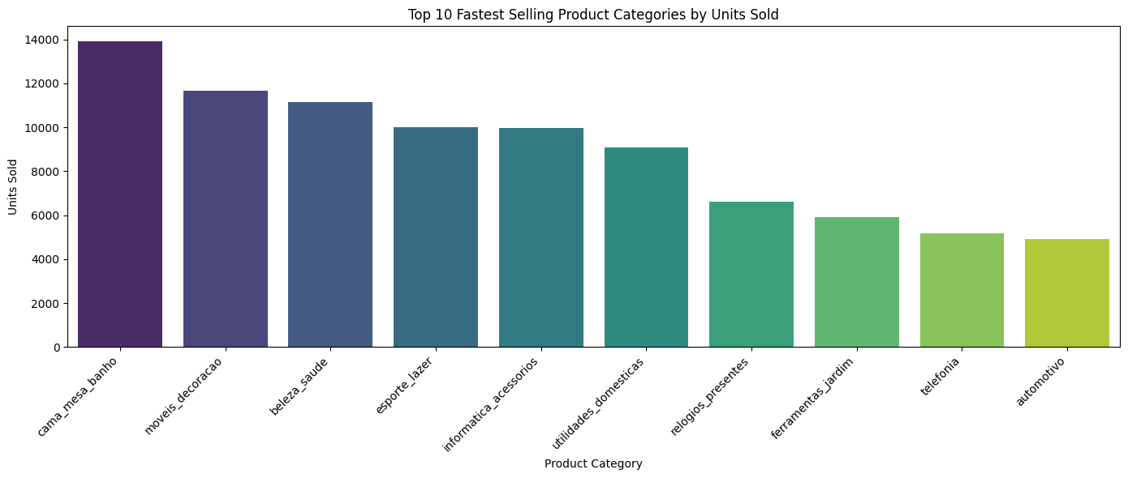
Top 10 Product Categories by Total Revenue
Demonstrates which product categories drives the most revenue on the platform.
Categories like beleza_saude and relogios_presentes dominate revenue, suggesting higher price points or premium demand.
Lower-revenue categories still sell but may rely more on volume or lower margins.
Top 10 Fastest-Selling Categories by Units Sold
Demonstrates which categories sell the largest number of units, regardless of price.
Categories like cama_mesa_banho and moveis_decoracao lead in volume, meaning they have high demand and steady turnover.
These may generate lower revenue per item but depend on mass purchasing behavior.
Notes:
D

Slide 9
03
Modeling
Notes:
ahrar

Slide 10
Modeling
Data Preparation
Target Definition
Merging of the 7 datasets
Filtered the new products with full 60 day windows
Made key features based on the existing variables
Defined Top 10% products by 60-day units as “successful”.
Introduced momentum segmentation
  Trending Front Loaded ( early spike -> flatten)
  Late Bloomers (slow start -> accelerates)
Modeling
Train/Test Strategy
Trained multiple ML models:
  Logistic Regression
  Random Forest
  Gradient Boosting
Tuned hyperparameters for best precision on early winners.
80/20 split
The positive class ~15%
Notes:
ahrar

Slide 11
Target Label Creation
Calculates Units Sold per Product & Time Window
  units60: Total units sold in days [0, 60]
Defines Bestseller Threshold
  Compute the 90th percentile of units60 distribution across all products
Creates Binary Label
  Assign Best_Seller_60 = 1 if units60 ≥ threshold_60, else 0
Computes Early Momentum Features
  Calculate early_momentum_7 = units7 / units60 (ratio of early sales to total)
Example: units7 (Days 1-7) = 292 units, units14 (Days 1-14) = 336 units, units60 (Days 1-60) = 351 units (Front Loader behaviour)
The top 10% of products sell 56+ units in their first 60 days (threshold_60= 56)
If units60 ≥ threshold then Best_Seller_60= 1 else 0
351 ≥ 56, therefore Best_Seller_60= 1
Early_momentum_7 ratio = 292/351 = 0.832 which is higher than 0.75, therefore classified as ‘Trending’
Notes:
ahrar

Slide 12
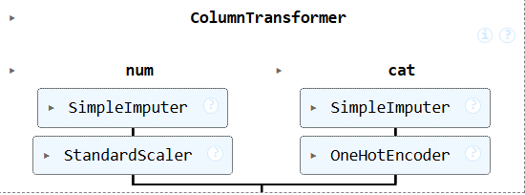
Overview of Modeling
Features
2. Pre Processing Pipeline
3. Baseline Models
Numeric features used:
['units7', 'units14', 'price', 'freight_value', 'delivery_time_days', 'freight_ratio']
Categorical features used: ['product_category_name', 'seller_id', 'order_status']
9 features and 1 target variable
The 5 models:
Logistic Regression
Random Forest
Decision Trees
Gradient Boosting
SVM
4. Param Grids/ CV
5. Test Set Validation
5 split StratifiedKFold
scoring="balanced_accuracy"
Notes:
Ahrar
StandardScaler transforms numeric features so that each feature has:
mean = 0
standard deviation = 1

Slide 13
04
Results
Notes:
R

Slide 14
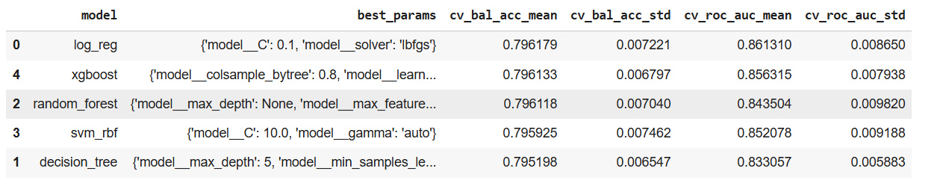
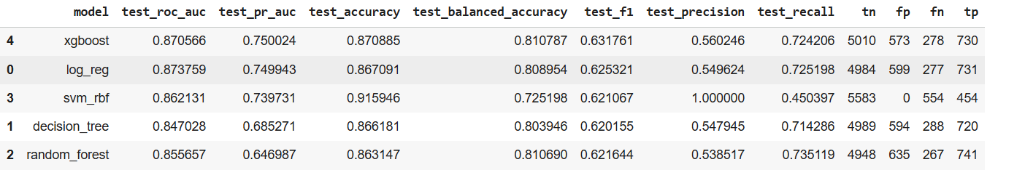
Train vs Test Performance
Train and test Balanced Accuracy were similar → no overfitting
Confirms the model generalizes well to unseen product launches
Time based split also validates real world deployment reliability
Notes:
Rahul

Slide 15
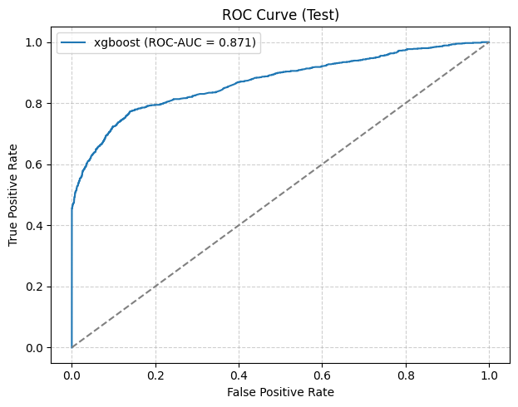
ROC
The ROC curve demonstrates strong separation ability, confirming that early sales indicators are predictive of 60-day success.
Balanced Accuracy was used due to class imbalance, and it aligns with the strong AUC, confirming the model reliably identifies both winners and non-winners
Notes:
Rahul
Balanced Accuracy = (TPR + TNR) / 2
Penalizes the model if it fails on the minority class
Ensures recall is not artificially suppressed
Encourages the model to learn both classes equally

Slide 16
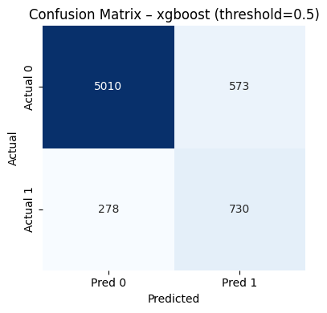
Confusion Matrix
True Positives → correctly predicted future best-sellers
True Negatives → avoids wasting marketing on weak products
False Positives → often “front-loaded” items that spike early but plateau
False Negatives → “late bloomers” caught by momentum segmentation
730/(5010+573+278+730)=0.111
Notes:
Rahul

Slide 17
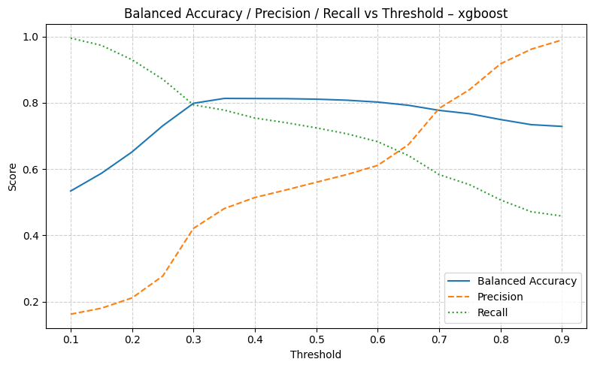
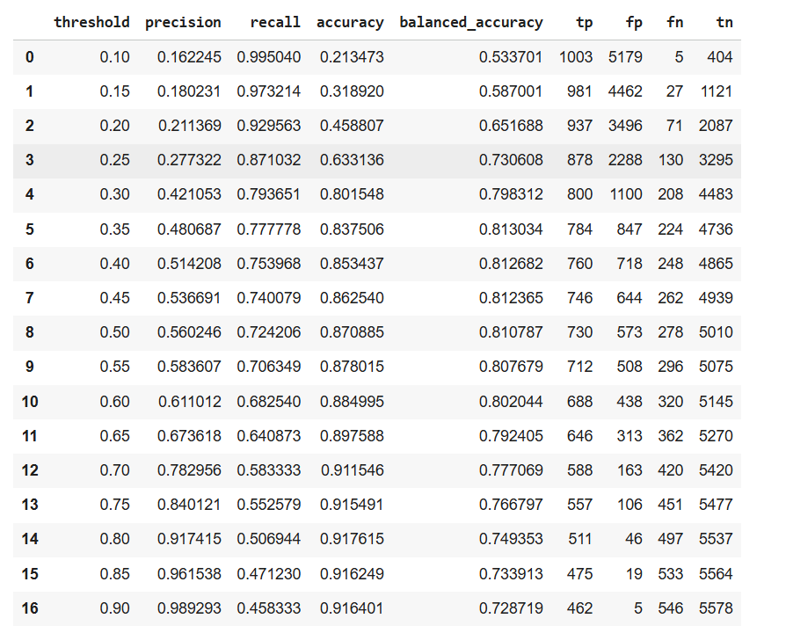
Precision Recall Graph
Notes:
Rahul
Precision = How reliable are our positive predictions
Recall = How many true bestsellers we successfully catch

Slide 18
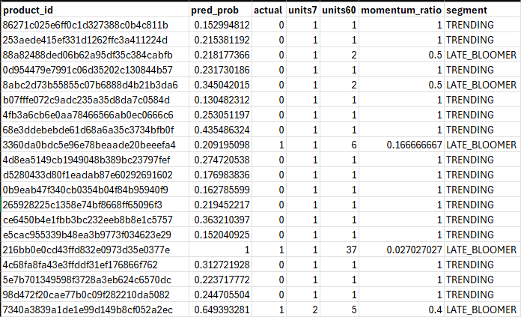
segmented_predictions.csv
Identifies false positives (early spikes that don't sustain) vs false negatives (slow starts that become winners)
Trending(FRONT_LOADED) + high prob → "Flash deal" (Days 1-7, capture the spike)
LATE_BLOOMER + high prob → "Watch & nurture" (Days 15-60, recheck at Day 28)
Notes:
Rahul

Slide 19
05
Conclusion
Notes:
L

Slide 20
Recommendations
Challenges
Next Steps
Adopt category specific seasonal segmentation thresholds
Flag non best sellers for better images, price, description, etc.
Homepage slots, and paid ads to the top slice
Does not capture external influence such as brand image and quality
Parameter tuning revealed that simpler models often beat complex ones
Defining the appropriate label
Further analysis on segmented predictions.csv
Expand feature engineering to include external factors.
Implement A/B testing to validate business impact
Notes:
L

Slide 21
Google Colab Link:
https://colab.research.google.com/drive/1FQHHjC4g98R9T_1YLuvtLpsVWRc4Wm7X#scrollTo=ZbEXlD5m5MiN

Slide 22
Thanks
Thank You!
Any questions?

